Slide 1
MIKE 11
Boundary Editor

Slide 2
BOUNDARY EDITOR
Specification of HD Boundaries
Network Editor (.nwk11)
Cross Section Editor (.xns11)
Simulation Editor (.sim11)
Boundary Editor (.bnd11)
Parameter Editor (.HD11)
Time Series Editor (.dfs0)

Slide 3
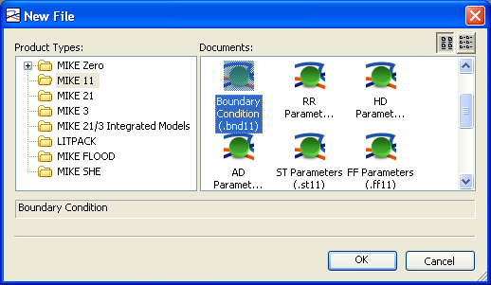
BOUNDARY EDITOR
*.BND11 File Extension
How? MIKE Zero -> File -> New -> File -> MIKE 11 -> Boundary Condition (.bnd11)
Boundary Editor Used to Specify Type and Location of Boundaries, and Assign Time Series or Values

Slide 4
BOUNDARY EDITOR
Two Editing Panels
Overview Panel
(List of All Boundaries in the Model)
Options for Including Advection/Dispersion and Stratified Flow Boundary Conditions
Specification Panel
(Details for Boundary Highlighted Above)

Slide 5
BOUNDARY EDITOR
Overview Panel
Boundary Type: - Inflow
- Water Level
- Q-h
- Bottom Level
- Sediment Supply
- Sediment Transport
User
Defined
Identifier
Boundary Description: - Open
- Point Source
- Distributed Source
- Global
- Structures
- Closed
Boundary Location: - Branch Name
- Chainage (Start)
- Chainage (End) (End Chainage only used
with Distributed Sources)

Slide 6
BOUNDARY EDITOR
Specification Panel
TS Type: - Time Series (TS) File
- Constant Value
TS Info: - Displays Item ID from DFS0 File
Browse / Edit Time Series File
Uses Time Series Editor

Slide 7
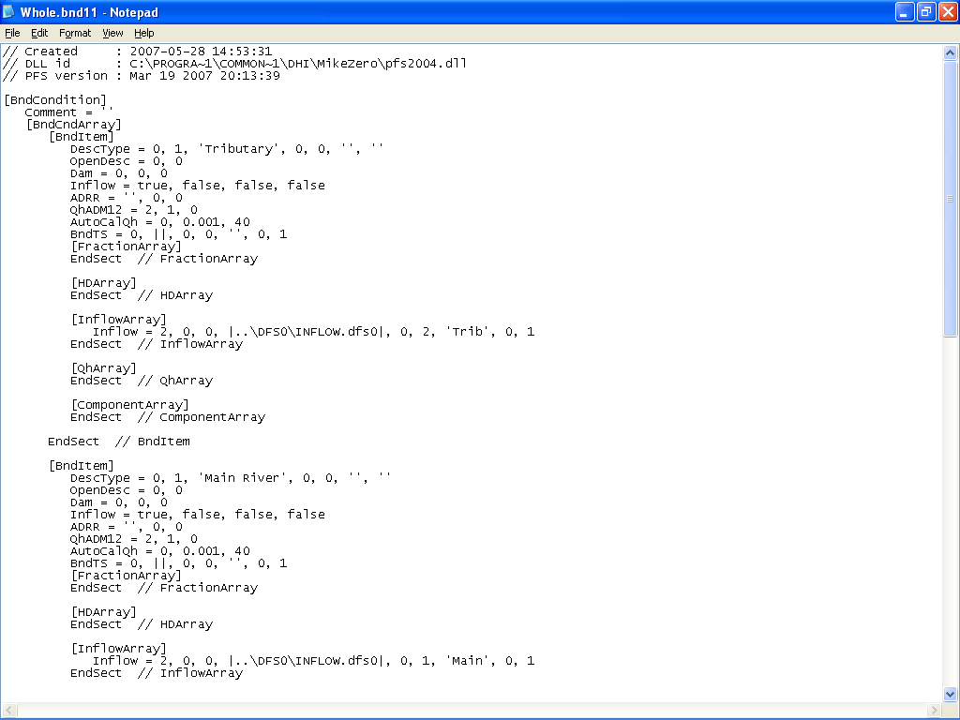
BOUNDARY EDITOR
Editable Text File
The Boundary File can be Edited in any Text Editor

